Slide 1


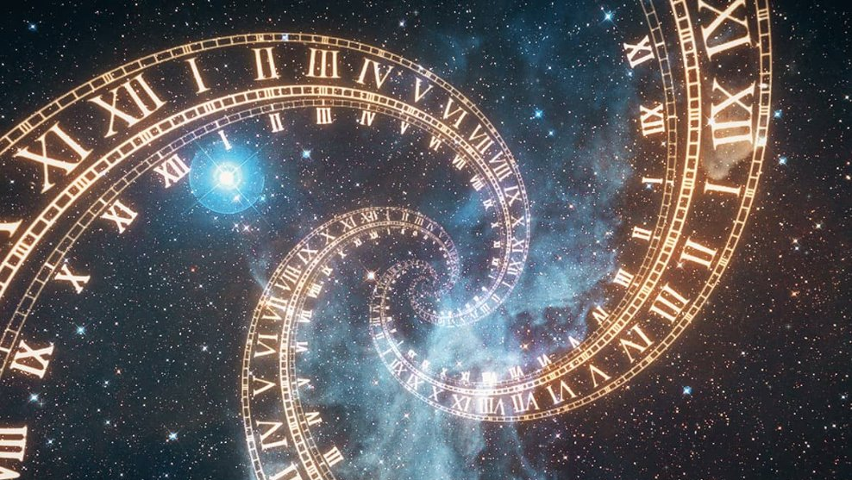
Defuse the Bomb Presentation
By: Maddie, Kate, Ashari, TJ

Slide 2
Time Travel Story
You are stuck in time with your broken time machine!
You realize many functions (button, wires, toggles, keypad ) need to be addressed and fixed .
Once you solve them, you can get back to 2026! If not... your time machine will blow up and you will be stuck in time forever!

Slide 3
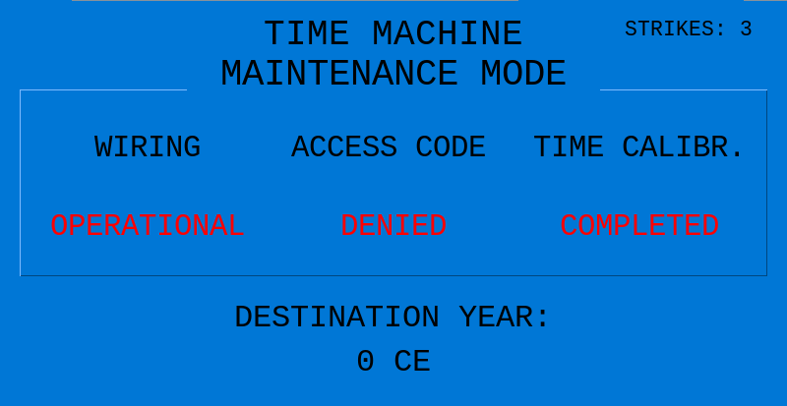
MAINTENANCE PAGE
The time machine displays this page to the user
Every piece of red text is an unsolved phase. Except for the destination year, that is the fourth phase.
Strikes are shown in the top right corner. If you reach 0 strikes, the time machine will explode.
If you successfully complete all the phases, you will travel back to the year 2026 CE

Slide 4

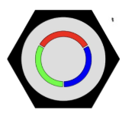
Button Function
The button will blink an error code that will determine how many times you must press the button to access the machine’s time travel features
This error code will also be used in the other components to disarm the rest of the bomb
You will receive a strike if you input the wrong amount of button presses

Slide 5
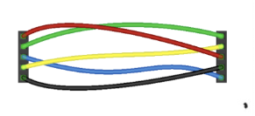
Wires Function
Wires correspond with color sequence displayed on the button
The player must "cut" one wire according to the button error code
If the player pulls the wrong wire, they automatically fail

Slide 6
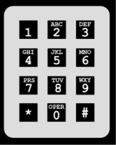
Keypad Function
Using the error code from the button, figure out the order in which the images are being presented.
Once that is figured out, you must find the years that correlate with each image and put them in order based on the pattern map listed in the manual.
You will receive a strike if you type the wrong year or the years in the wrong order.

Slide 7
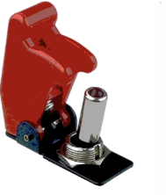
Toggles Function
You must set your destination year before using the time machine
The time machine uses the toggles as the method to select this destination year. Each toggle corresponds with a mathematical operation which changes based on the button error code
Your desired destination will always be 2026 CE

Slide 8
Team Dynamic and Goals
Goals
Dynamics
Make sure each member had a clear role
Finish on time while still leaving room for testing and improving
Figure out how the wires, keypad, and toggles could interact together with the button function without bugs or errors
We met the goals of this project by dividing responsibilities by components
After finishing our components, we worked together on the visuals such as the GUI, presentation, and manual
We stayed connected through a group chat to ask each other questions, so we were all on the same page

Slide 9
Future Development
If we had another term to work on this project, we would make our defusing process for the bomb more complex, for instance:
Do morse code for the button function
Add more images/years for the user to guess
Make use of the Makerspace for better individuality in our project
Add extra effects such as music, sound effects, etc..
Add hidden failure states for all of the years possible with the toggles step. E.g. get sent to 1351 CE
Use a sequential process for solving the bomb, so we can introduce more complexity

Slide 10
Reflection
This project has helped us:
Work more effectively as a team
Improve our understanding of coding concepts
Learn how to manage time and stay organized for long projects
This project will help in future classes by:
Improving our ability to break down complex problems into smaller steps
Building new confidence using new technologies tools, and hardware
If we had the freedom to redesign this project, we would:
Have more formal lessons on how to use GitHub
Add more flexibility for different skill levels
Allow for a short revision/resubmission period for feedback
Challenges that we had included:
Making sure our code would not accidently mess up each others code as all the functions relied on the button mechanics.
The Gui and Gifs creating errors and messing with the display of our bomb.

